Slide 1
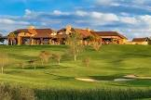
Robson Ranch Denton HOA
Golf & Greens Committee
May 16, 2022

Slide 2
Robson Ranch Denton HOA
Golf Statistics

Slide 3
Annuals & Playcards

Slide 4
Rounds of Golf - April

Slide 5
Rounds of Golf - YTD

Slide 6
Revenue by Type - April

Slide 7
Revenue by Type - YTD

Slide 8
When do Residents Play 9 Holes

Slide 9
When do Residents Play 18 Holes

Slide 10
Rounds of Golf Actual vs Budget
Days Closed
4
1
6
10
Notes:
Year to date golf rounds played are 17,771 as compared to budget of 18,634. Only a gap of 863 rounds. Not too bad considering the winter we experienced.

Slide 11
Average Price of Golf Actual vs Budget
Net of comp rounds

Slide 12
Average Price per Round by Type

Slide 13
Cart Traffic
Robson Ranch Denton HOA
Estimated Golf Cart Traffic
 | Apr-22
 | Monday | Tuesday | Wednesday | Thursday | Friday | Saturday | Sunday | Total
Resident Play | 116 | 437 | 866 | 672 | 996 | 894 | 463 | 4,442
Non-resident Play | 5 | 17 | 12 | 229 | 118 | 147 | 70 | 597
Golf Now | - | 9 | 47 | 73 | 81 | 183 | 68 | 461
Total Rounds | 120 | 463 | 925 | 973 | 1,195 | 1,223 | 601 | 5,500
Percentage Resident Play | 96% | 94% | 94% | 69% | 83% | 73% | 77% | 81%
Percentage Non-Resident Play | 4% | 6% | 6% | 31% | 17% | 27% | 23% | 19%
Assumptions:
Two to a cart for non-resident play
One to a cart in resident play
Number of Carts on Course | 118 | 450 | 895 | 822 | 1,096 | 1,058 | 532 | 4,971
Number if we go to 2 in Cart on Weekends | 118 | 450 | 895 | 822 | 598 | 612 | 301 | 3,795
Percentage Reduction | 0% | 0% | 0% | 0% | 45% | 42% | 44% | 24%

Slide 14
Year over Year Golf Now Sales - April

Slide 15
Golf Now Average Cost per Round
Golf Now Net Price per Year
Net of Comps

Slide 16
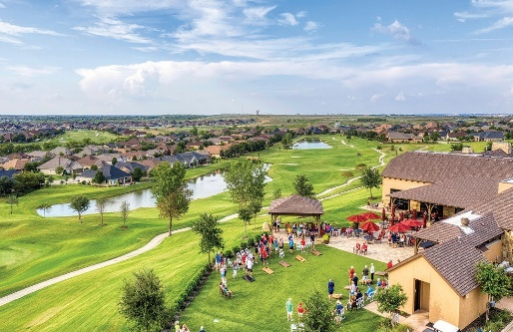
Golf Financial Results Actual vs Budget March 2022

Slide 17
Golf Financial Results Actual vs Budget
YTD 2022

Slide 18
Hard & Soft Goods Results
 | Month to Date |  |  | Year to Date |  |  | Annual
Revenue: | Actual | Budget | Last Year | Actual | Budget | Last Year | Budget
Hard Goods, net of discounts | $ 21,698 | $ 9,000 | $ 4,622 | $ 35,052 | $ 18,200 | $ 20,824 | $ 150,050
Soft Goods, net of discounts | $ 10,115 | $ 5,300 | $ 3,487 | $ 20,898 | $ 10,800 | $ 9,655 | $ 95,180
Total | $ 31,813 | $ 14,300 | $ 8,109 | $ 55,950 | $ 29,000 | $ 30,480 | $ 245,230
Cost of Goods Sold:
Hard Goods | $ 16,698 | $ 7,200 | $ 10,487 | $ 26,747 | $ 14,560 | $ 7,087 | $ 120,040
Soft Goods | $ 6,913 | $ 3,710 | $ 3,388 | $ 14,707 | $ 7,560 | $ 7,087 | $ 66,626
Total | $ 23,611 | $ 10,910 | $ 13,874 | $ 41,454 | $ 22,120 | $ 14,175 | $ 186,666
Gross Profit:
Hard Goods | $ 5,000 | $ 1,800 | $ (5,864) | $ 8,304 | $ 3,640 | $ 13,737 | $ 30,010
Soft Goods | $ 3,202 | $ 1,590 | $ 99 | $ 6,192 | $ 3,240 | $ 2,568 | $ 28,554
Total | $ 8,202 | $ 3,390 | $ (5,765) | $ 14,496 | $ 6,880 | $ 16,305 | $ 58,564

Slide 19
Golf Financial Results by Cost Center

Slide 20
Tournament Pro-forma
Robson Ranch Denton HOA
Proforma of Tournaments
 |  |  | Golf | Price per | Other
 |  | Rounds | Revenue | Round | Revenue
DBU |  | 207 | $ 9,700.02 | $ 46.86 | $ 4,099.98
UNT |  | 33 | $ 1,155.00 | $ 35.00 | $ 1,056.00
Miss Texas |  | 60 | $ 2,400.00 | $ 40.00 | $ -
Support our Troops |  | 68 | $ 2,040.00 | $ 30.00 | $ 2,387.50
 |  | 368 | $ 15,295.02 | $ 41.56 | $ 7,543.48
Estimated Additional Labor |  |  |  | $ 1,339.00
Average Annual Price |  |  |  | $ 29.14
Average Resident Dailies |  |  |  | $ 46.71

Slide 21
Robson Ranch Denton HOA
Operations Report

Slide 22
Craig’s Comments
Summer Promotion “ Great Balls of Fire” to begin in mid June
Receive 2 sleeves of Ball when purchasing an afternoon Tee Time.
Texas Women’s Open June 1-3 with Practice rounds on May 31
152 players
Wednesday and Thursday Tee times
Double Tees 7:30-9:30 and 12:30-2:30
Friday Tee times
Top 50 players
Single Tees starting at 7:30

Slide 23
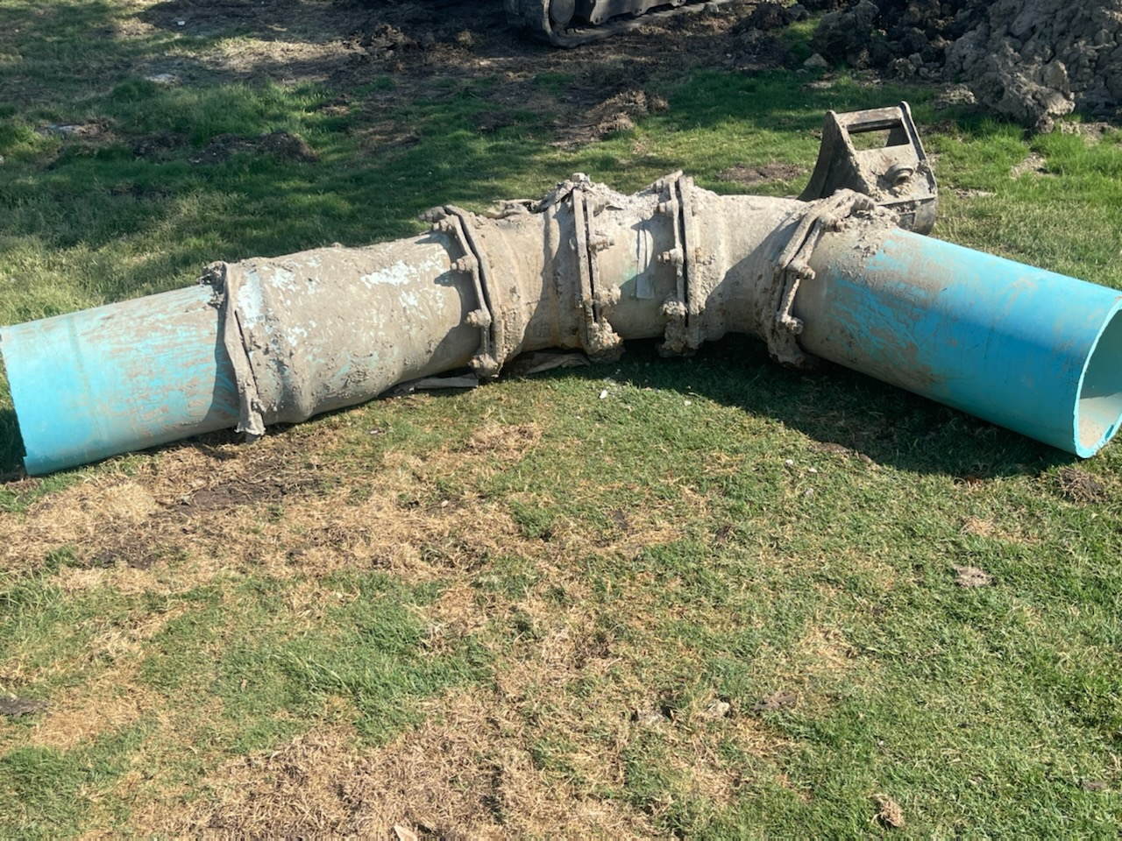
Ryan’s Comments
14 inch mainline repair at 9 South pump station. This work is being preformed using RR labor. Cost would be $20,000+ if a contactor was used. This leak was caused by the corrosive nature of our water.

Slide 24
Ryan’s Comments
Since the mainline has been down we have increase the time it takes to water and reduced the volume per night to accommodate of the loss of 2,000 gpm (gallons per minute).
Well #2 in operational at a reduced rate of 350 gpm.
Last week we finished fertilization that was delayed due to rains. This will help fill in the weaker areas. Due to cart traffic we will be adding additional fertilizer specifically in areas that are struggling.
Upcoming: Major Aerification of all short grasses June 6-9
White Tee on West 1 will open soon with Tif Tuff Bermuda

Slide 25
Old Business
Update on Bridge Repairs- Work is warrantied and contractor will add more screws. Contactor will be out in 2 months.
Update on Golf Course 101
2 per Cart- Open Discussion
Soft Drink Machine on West 6-Proceeding with installation, working with provider to set up a date for install.

Slide 26
New Business
Possibility of different drain grate on North 3- Looking into picking up some mesh from Fulton Metal
Possibility of creating Blue/White Combo Tees- Can be added to GHIN immediately. Just ordered 40,000 score cards so that change would not be able to take place for about 6 months.
Discuss complaints about Chelsea removing people form Tee Times
Missing Hazard stakes on left side of North 8 and right side of West 4
What is the cause of brown spots on many holes? These spots are indicative of weak areas on the course. This is caused by temperature and water quality(salinity). As growing season continues you will see these spots begin to dissipate.

Slide 27
New Business
Discuss Resident Only area on the driving range- Operations in not in favor of this change. Limitations are in place for High School Practice. Enforcement would also be an issue.
Discuss going back to Pre-Covid check in process- Ops is open to this change but would need additional staff in place to stream line the process.

Slide 28
Robson Ranch Denton HOA

